Slide 1

Day 4
Dependency Injection

Slide 2
Dependency Injection
A way to give a class the things it needs (dependencies) from the outside

Slide 3
Why?
Easier testing
Looser coupling = more flexibility
Reusability of code
Encourages good design

Slide 4
3 Types
Constructor Injection ✅
Property Injection
Method Injection

Slide 5
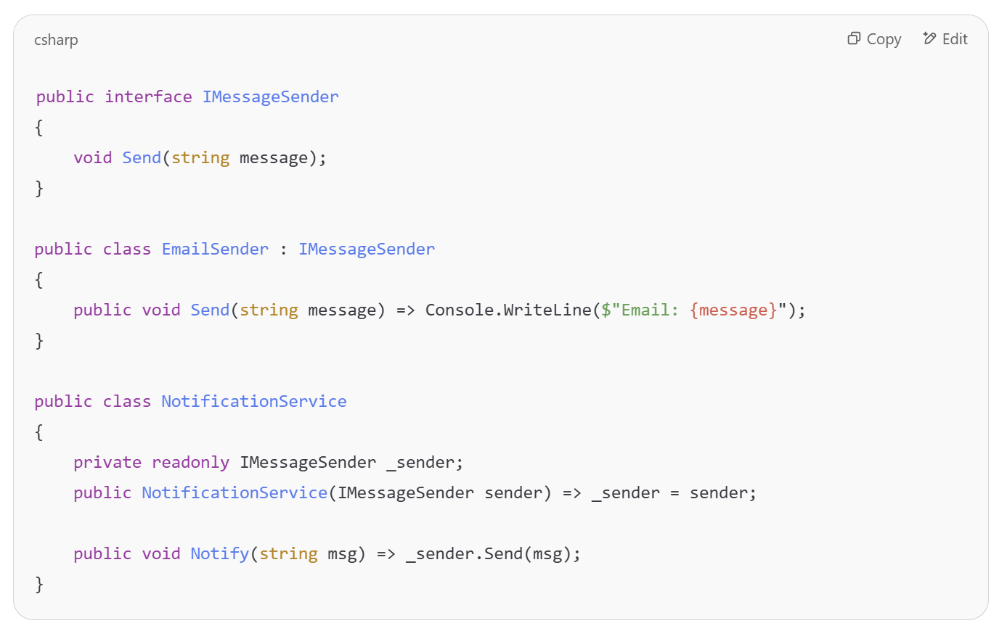
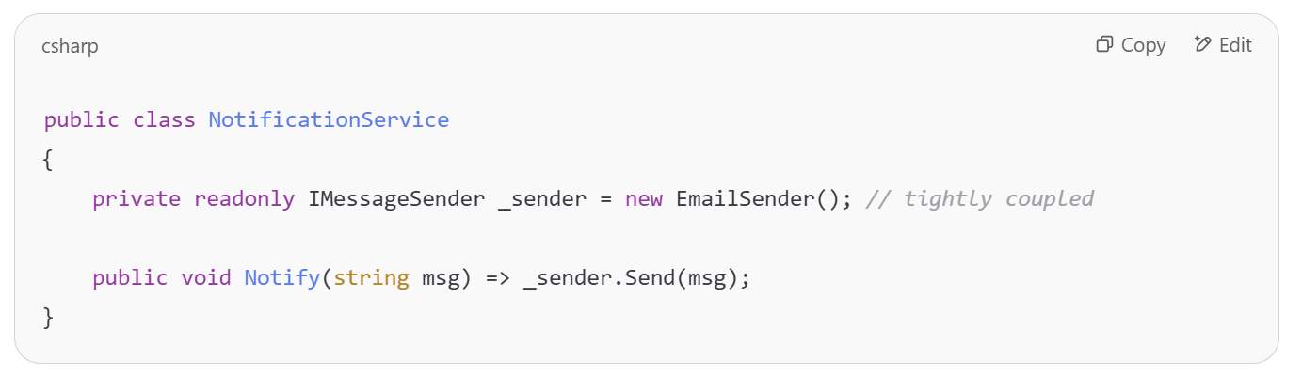
With vs Without

Slide 6
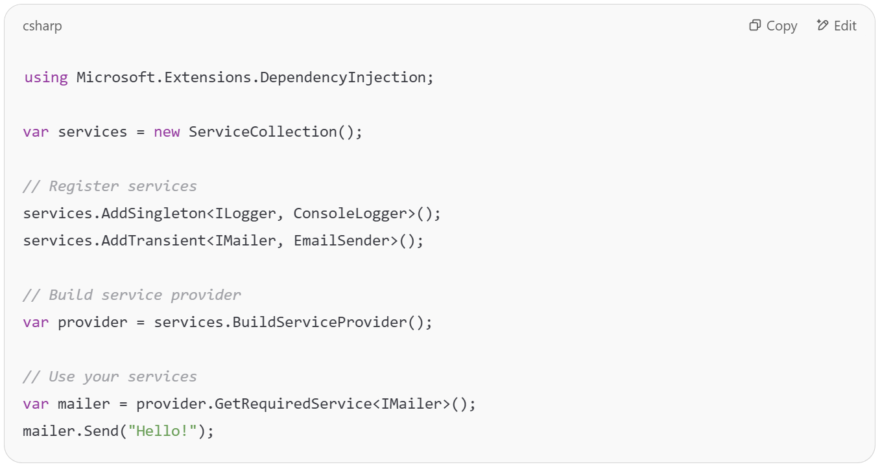
ServiceCollection

Slide 7
ServiceCollection
✅ Core of .NET’s built-in Dependency Injection
🔧 Used to register services with lifetimes
🧱 Foundation of HostBuilder and ASP.NET Core apps

Slide 8
Lifetimes
Singleton | One instance for the whole app
Transient | New instance every time it's requested
Scoped | One per request (web apps mainly)

Slide 9
Classic examples
ILogger
IConfiguration

Slide 10
Live Demo
Notes:
Create a console application with DI
Use ITaskManager
Explain the Singleton<..>
Show ILogger and IConfiguration
services.Configure<AppSettings>(context.Configuration.GetSection("AppSettings"));
public App(IOptions<AppSettings> options)
{
_settings = options.Value;
}

Slide 11
Exercise
Change your application to work with Dependency Injection
1
Use ILogger for logs
2
Use IConfiguration and appsettings.json for the filename
3

